Slide 1


Sensors
FlyNet: Autonomous Quadcopter Search and Rescue

Slide 2
Sonar
FlyNet: Autonomous Quadcopter Search and Rescue
Sonar Max MB 1200 (Broad Beam)
Most sensitive
Low power consumption
Less sensitive to noise clutter
Sonar Max MB 1240 (Narrow Beam)
Large target detection
Better acoustic noise rejection

Slide 3
Ultrasonics Specification
FlyNet: Autonomous Quadcopter Search and Rescue
Current drawn –
5V – 3.4mA
3.3V – 2.1mA
Min. reported distance – 20 cm
Max. range – 765 cm
Refresh rate – 99uS
Modes of operation
PWM
Analog
RS232
Auto calibrates

Slide 4
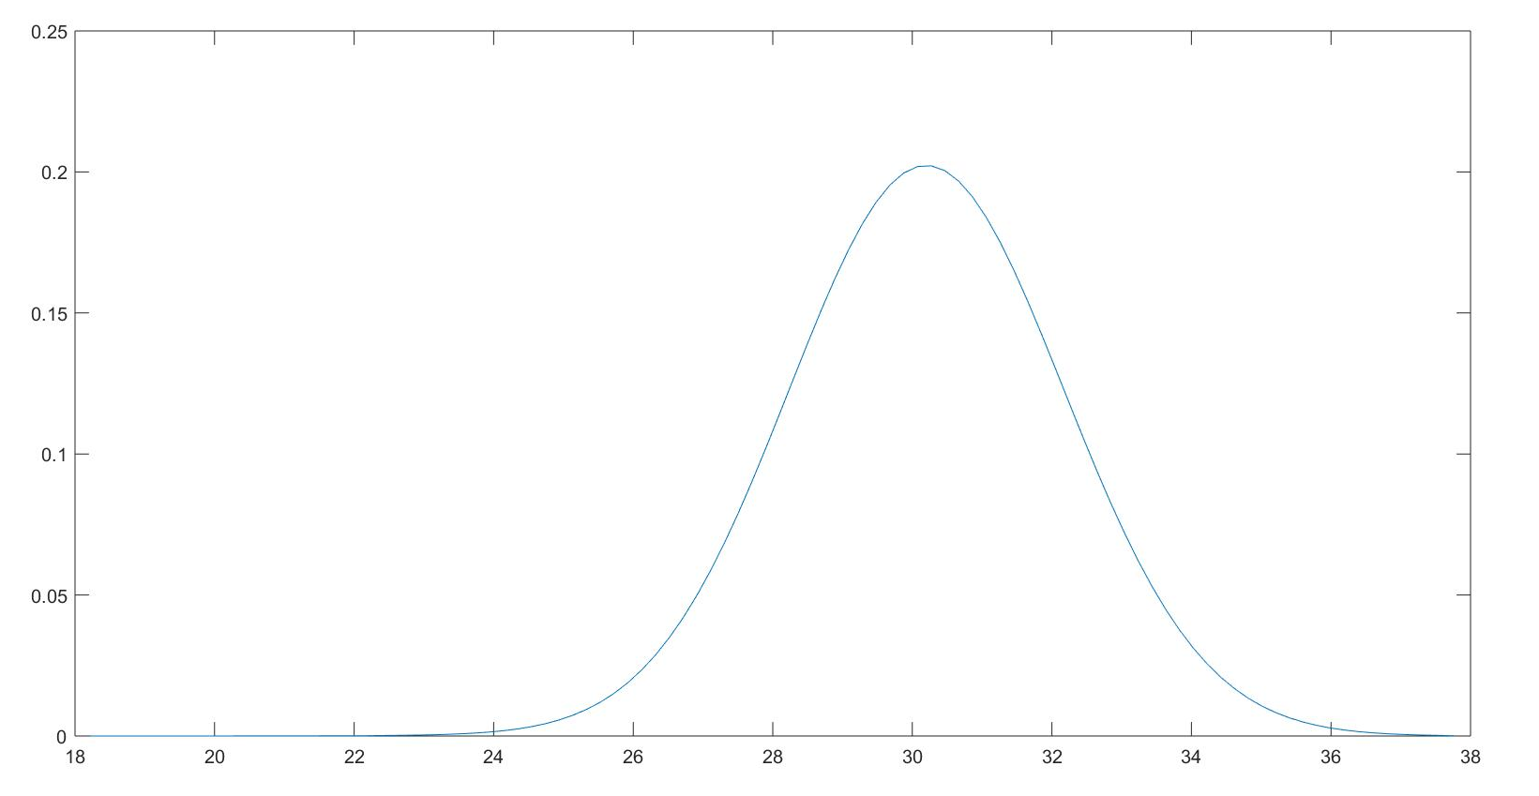
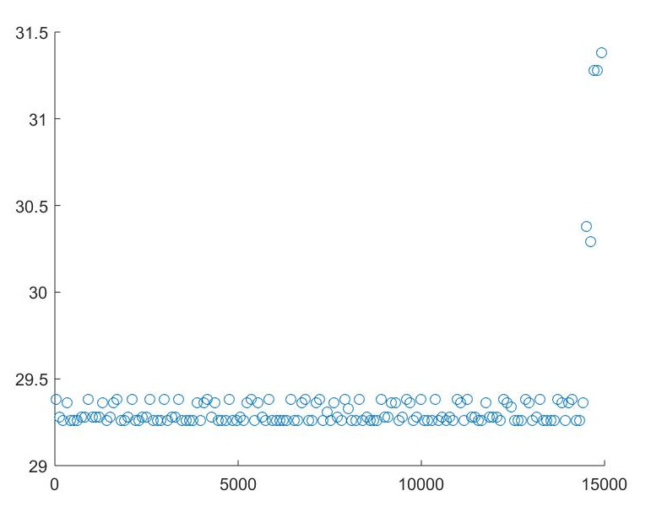
Plots
FlyNet: Autonomous Quadcopter Search and Rescue
Object placed 29 cm from sensor
Sonar Max MB1200 PDF – Analog Mode
Sonar Max MB1200 Scatter plot– PWM Mode

Slide 5
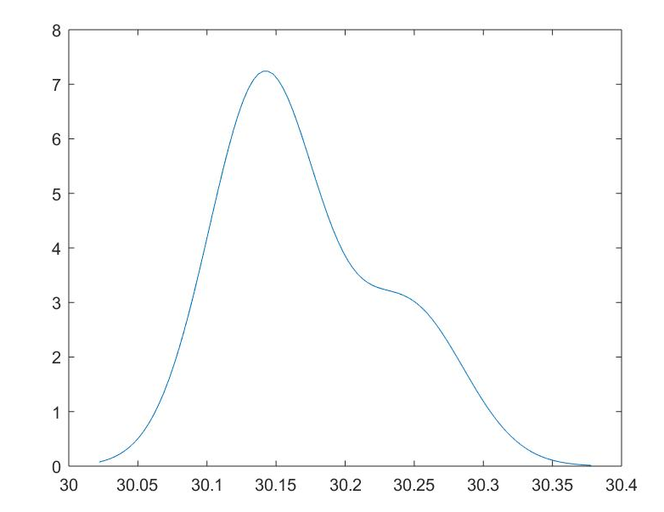
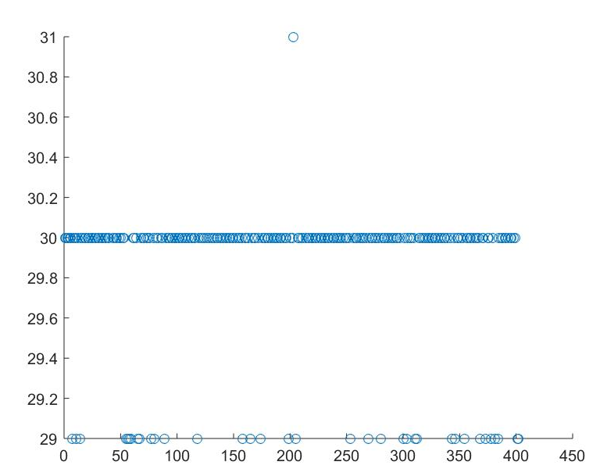
Plots
FlyNet: Autonomous Quadcopter Search and Rescue
Object placed 30 cm from sensor
MB1240 PDF PWM Mode
MB1240 Scatter Plot PWM Mode

Slide 6
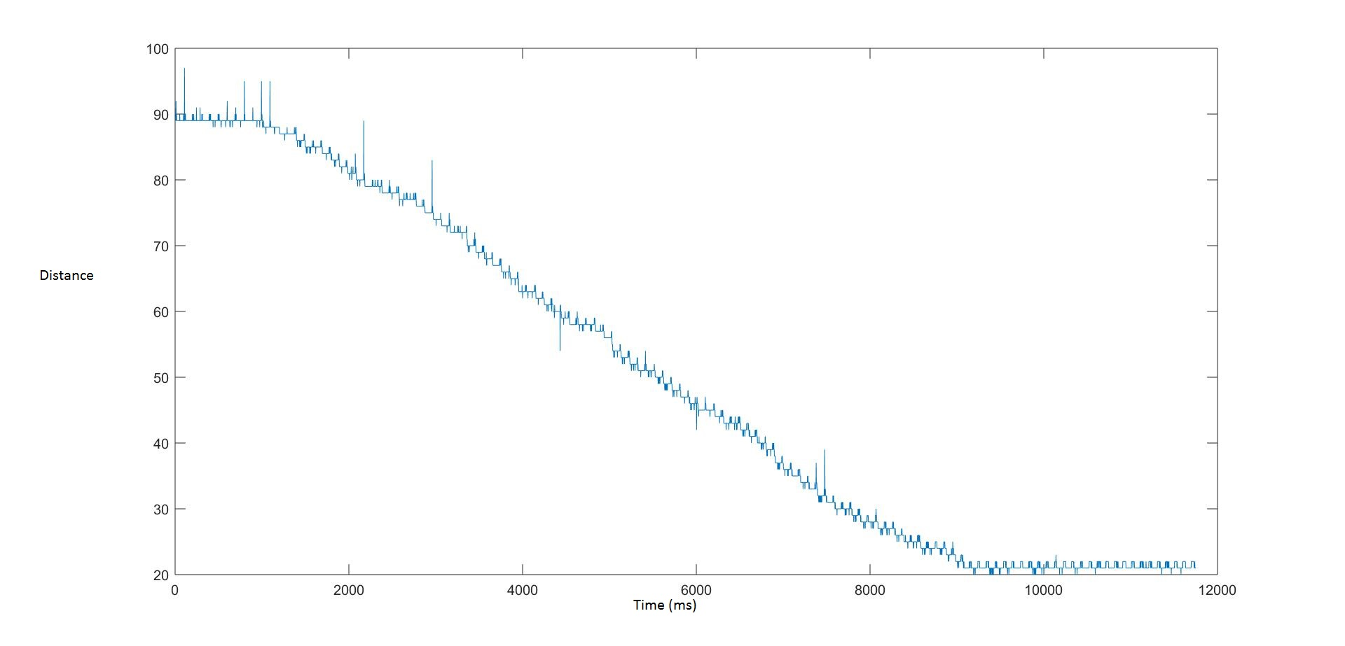
FlyNet: Autonomous Quadcopter Search and Rescue
Sensor moved from 90 cm to almost 5 cm from wall
MB1240 Plot When sensor is in motion

Slide 7
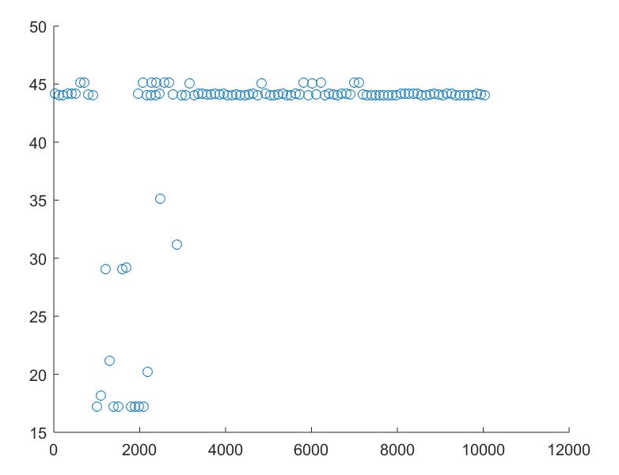
FlyNet: Autonomous Quadcopter Search and Rescue
Sensor placed 44 cm from wall
MB1240 in clutter
x axis – time in ms
Y axis – distance in cm

Slide 8
LiDAR
FlyNet: Autonomous Quadcopter Search and Rescue
Range 0-40m
Current consumption <100mA
Max Repetition rate – 500 Hz
Acquisition time 0.02 seconds
Modes of communication
I2C
PWM

Slide 9
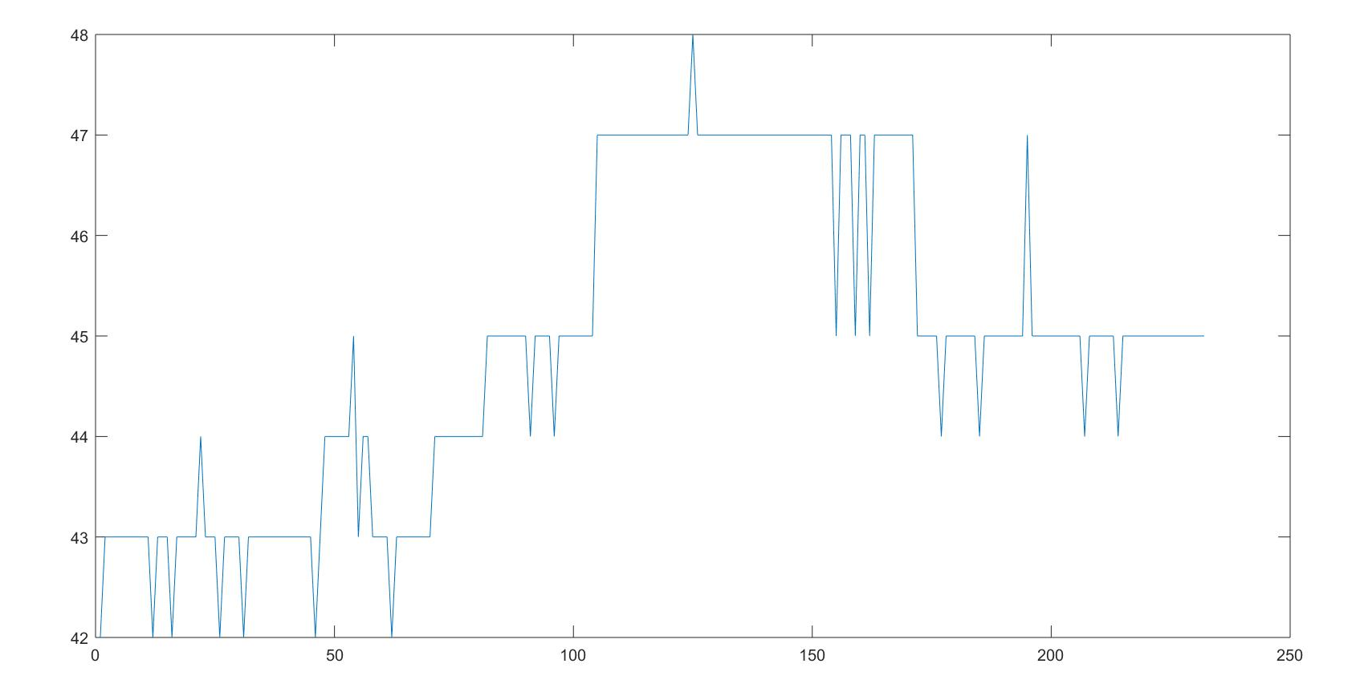
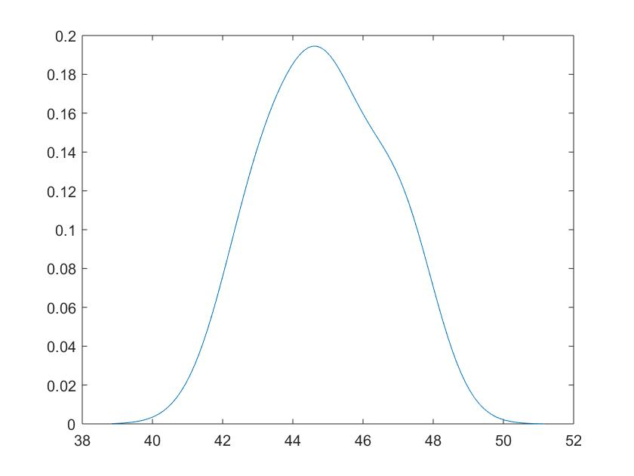
Plots
FlyNet: Autonomous Quadcopter Search and Rescue
LiDAR Lite Plot
LiDAR Lite PDF
Sensor placed 44 cm from wall

